Slide 1
Electric Power Subsystem (EPS)
Reece Krantz – Electric Power Subsystem Lead

Slide 2
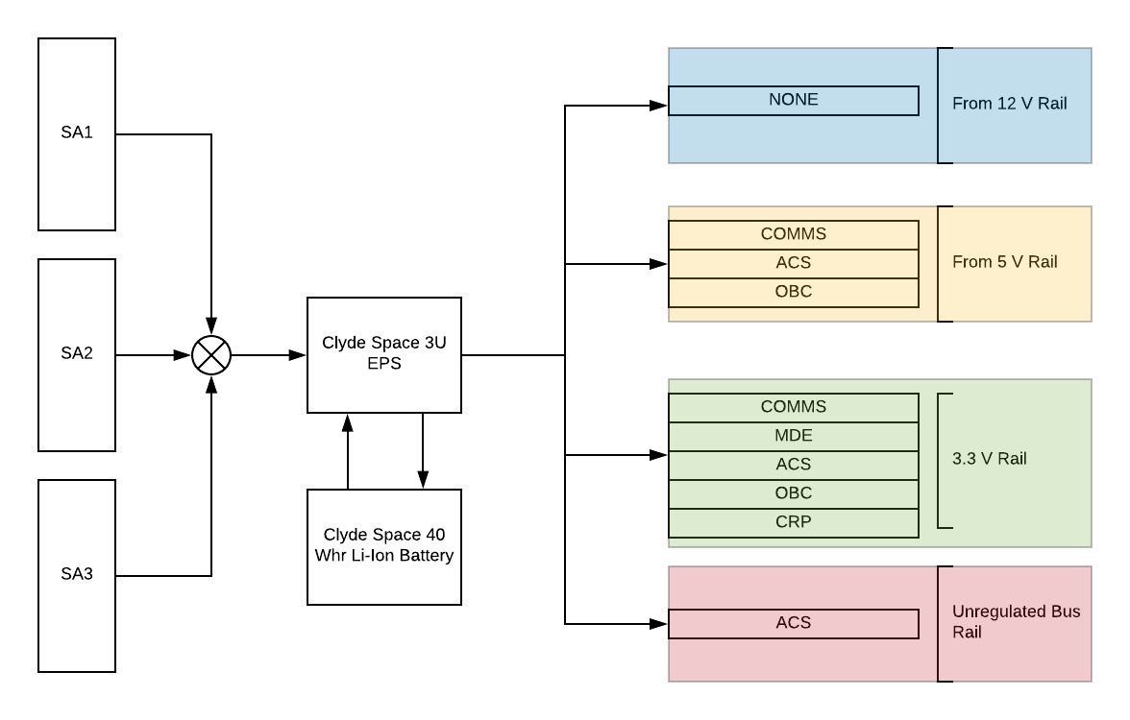
Mission Overview
The Electric Power Subsystem is responsible for the power management and distribution of the satellite.

Slide 3
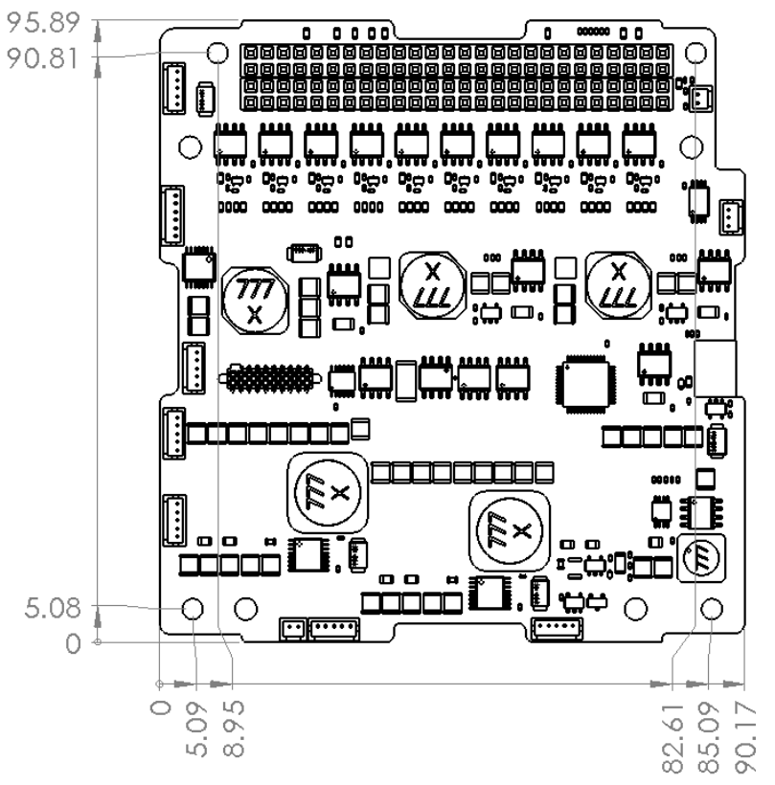
Clyde Space EPS Board
Maximum Ratings
  Buck BCRS – 30V
  SEPIC BCRS – 9.5V
  Battery – 8.3
  Operating Tempurature -- -40 to 85 C
  Storage Tempurature -- -50 to 100 C
  Vaccum – 10^-5 torr
  Radiation Tolerance – 10 kRad

Slide 4
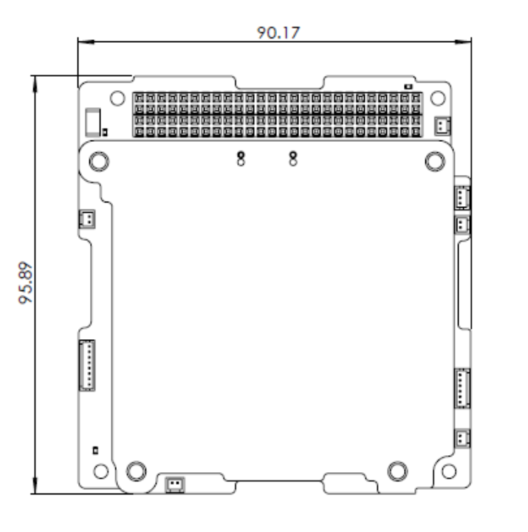
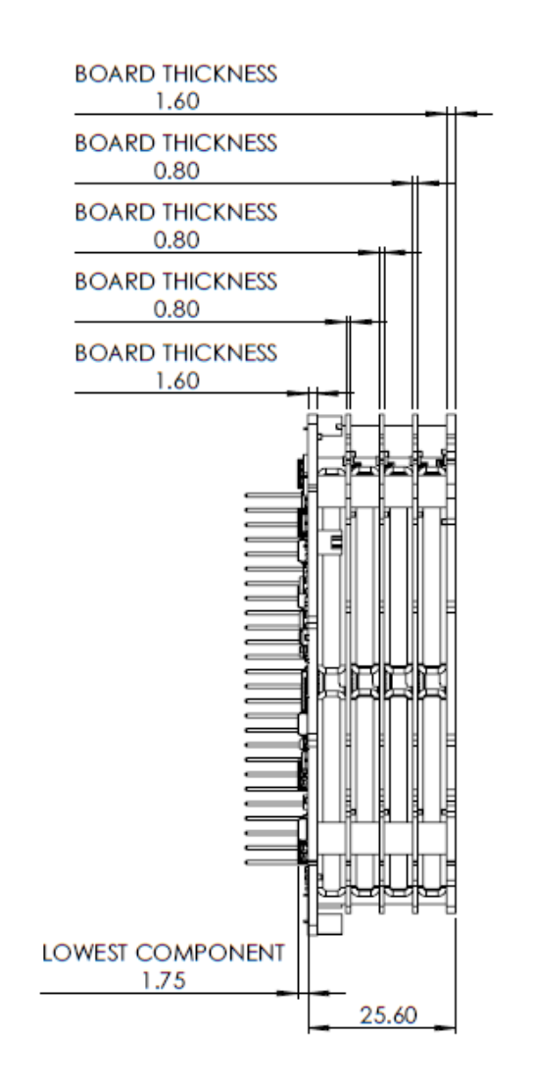
Clyde Space 40 Whr Battery
Operating Temp
  -10 to 50 C
Storage
  -10 to 10
Vacuum of 10^-5 Torr
Max Ratings
  Charge
    8.4 V
    8 A
  Discharge
    6.2 V
    8 A

Slide 5
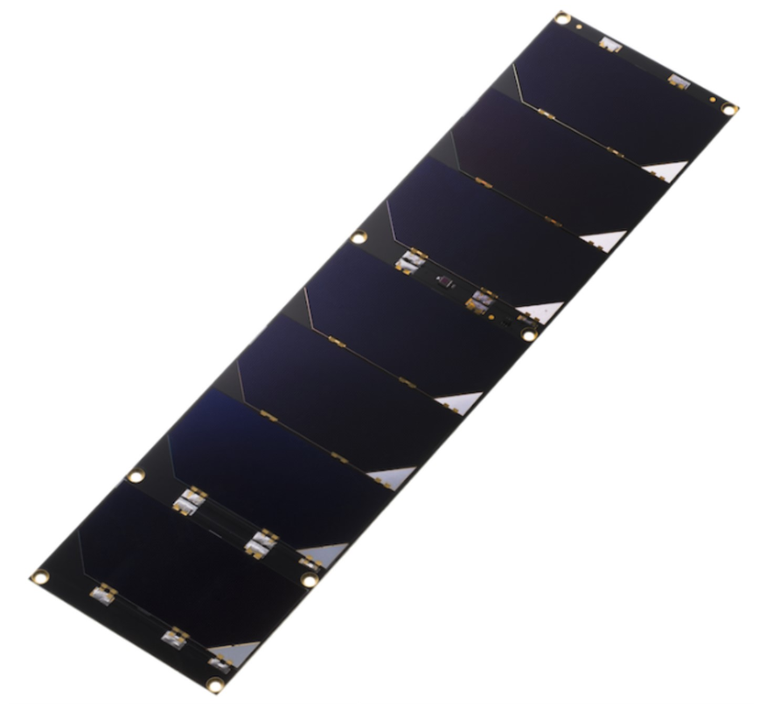
EnduroSat Solar Panels
  Seven CESI Solarcells
    211.05cm^2 effective cell area
    Temperature Sensor
    8.43 Watt in LEO
    Gyroscope and Sun Sensor
    Max Voltage of 16.31V
    Max Current 517 mA
    Weight of 136g

Slide 6
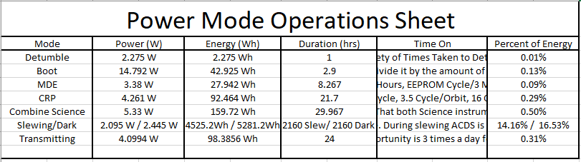
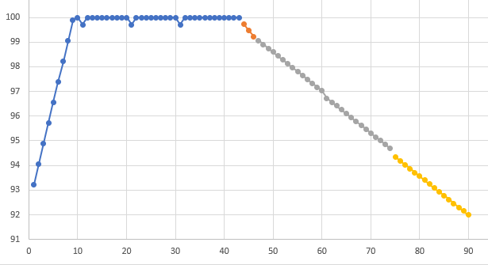
Power Modes
  Power Mode analysis allows unique modeling for any orbital configuration.

Slide 7
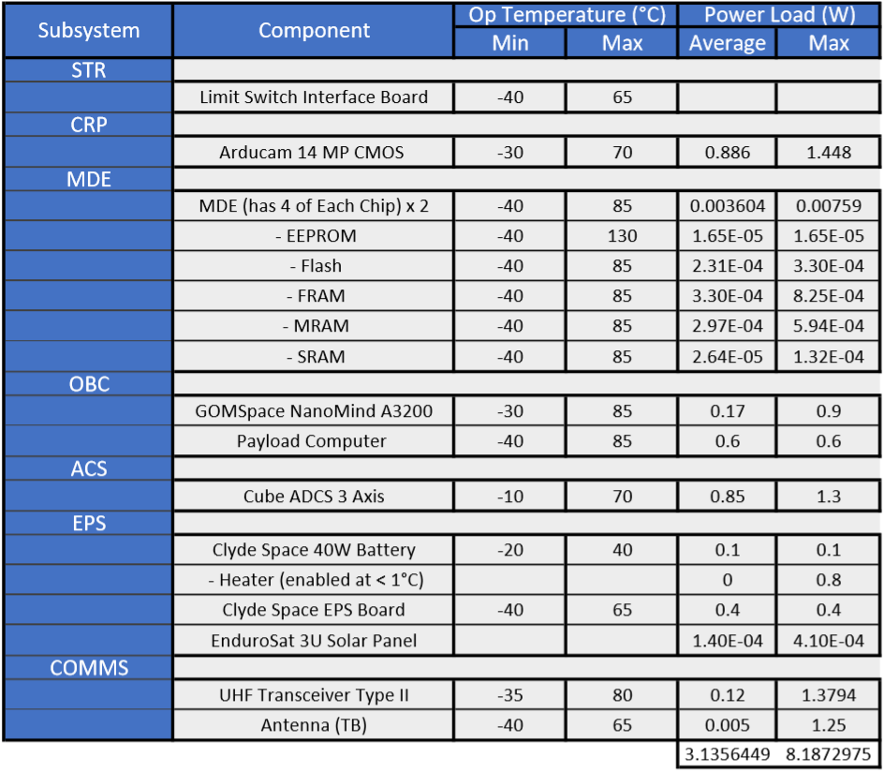
Power Budget

Slide 8
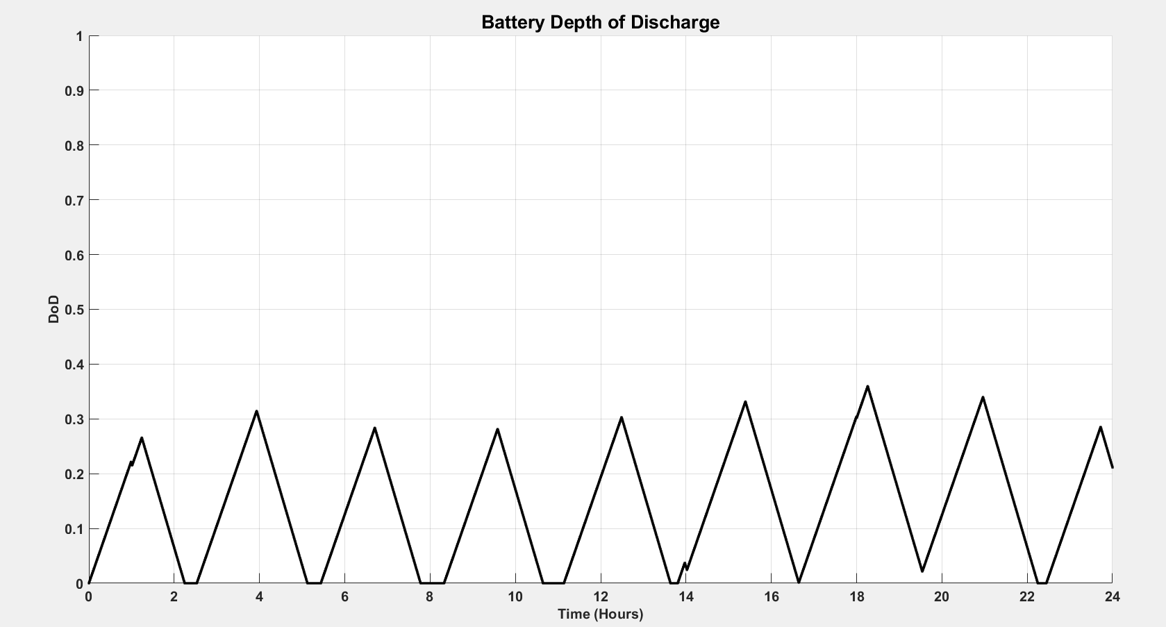
Depth of Discharge

Slide 9
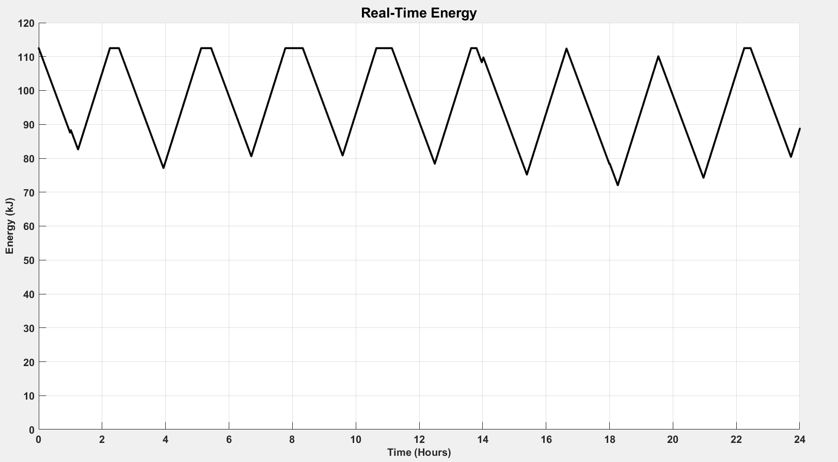
Real Time Energy

Slide 10
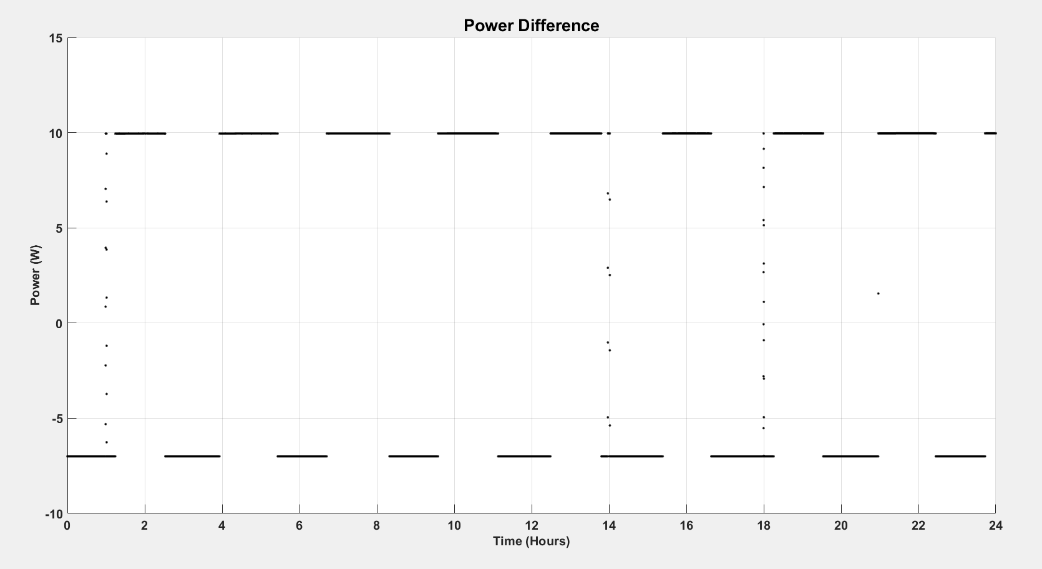
Power Difference

Slide 11
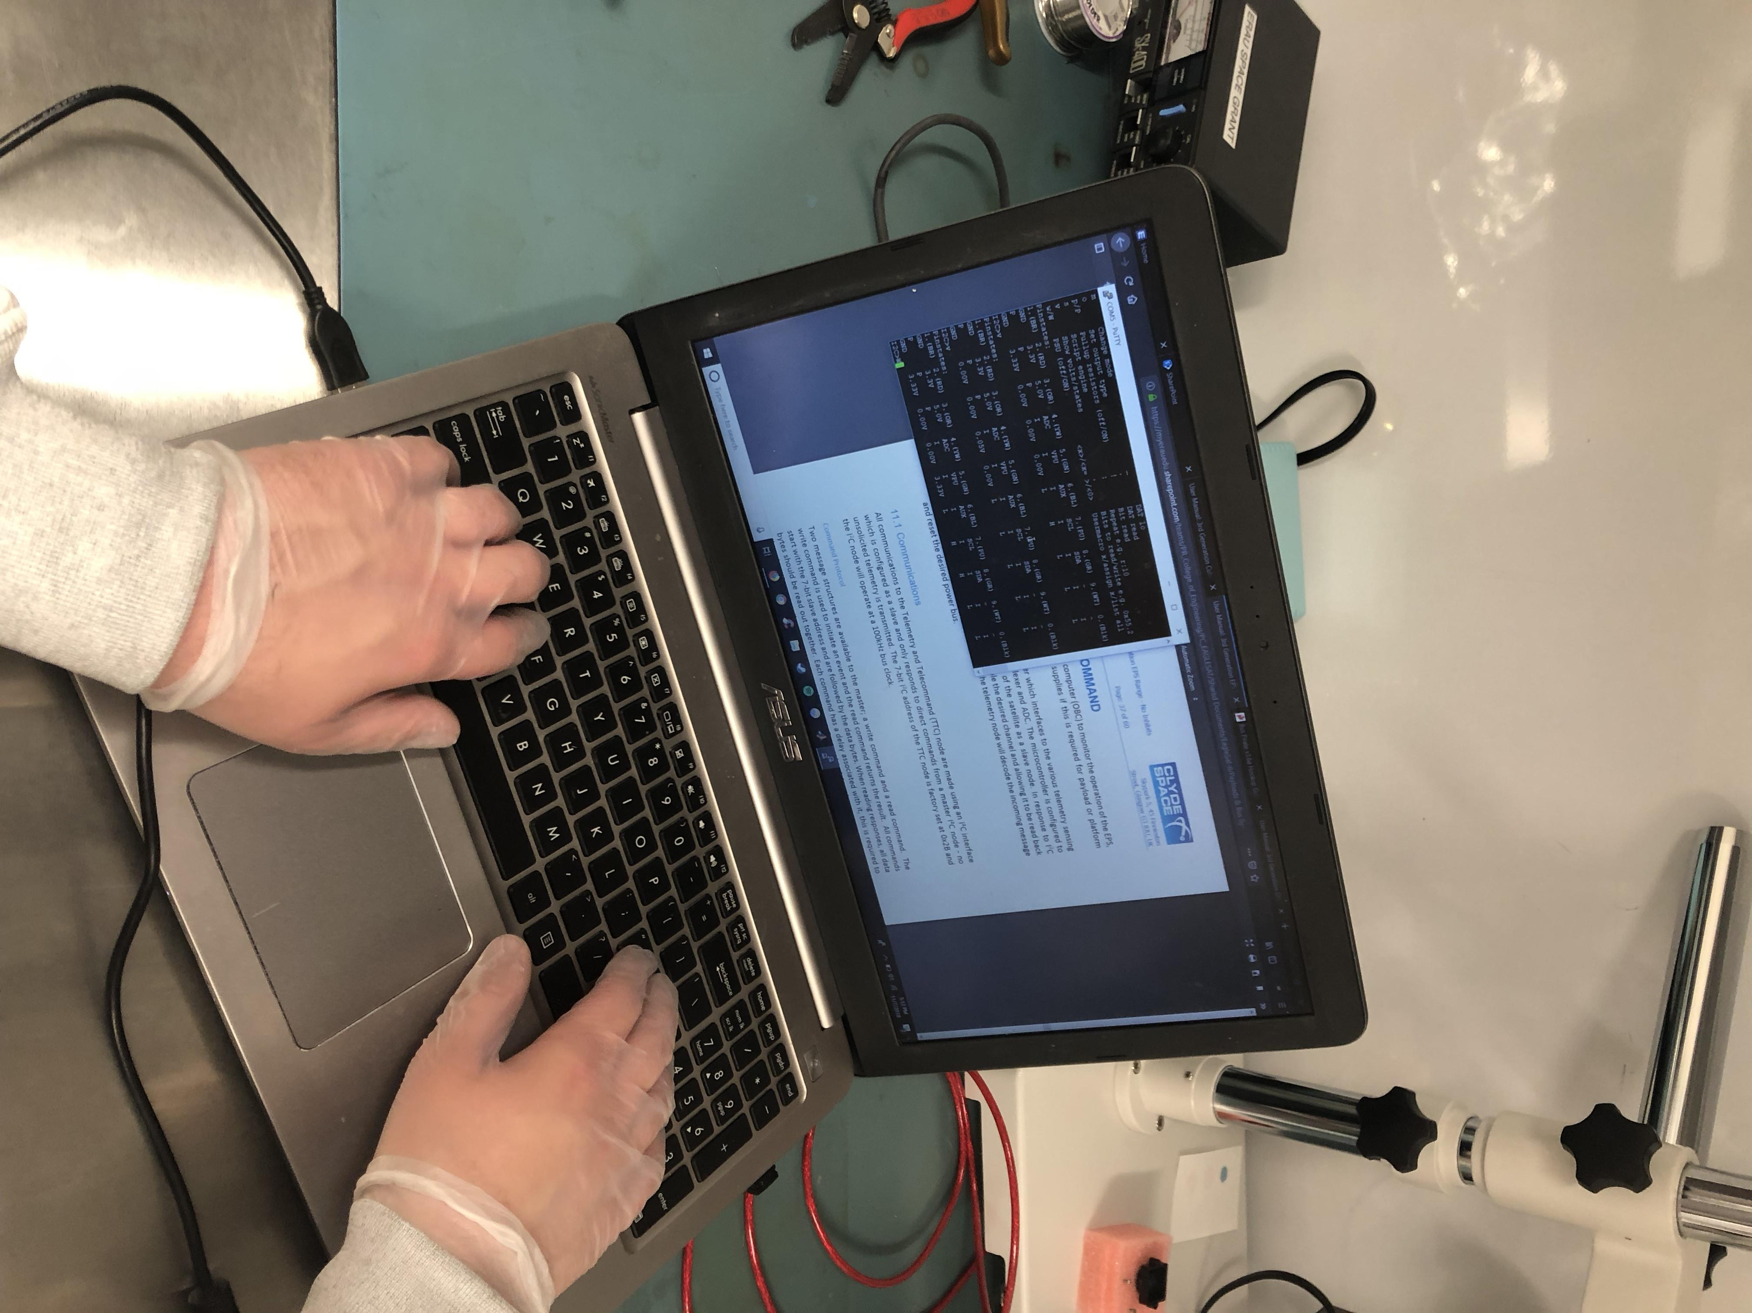
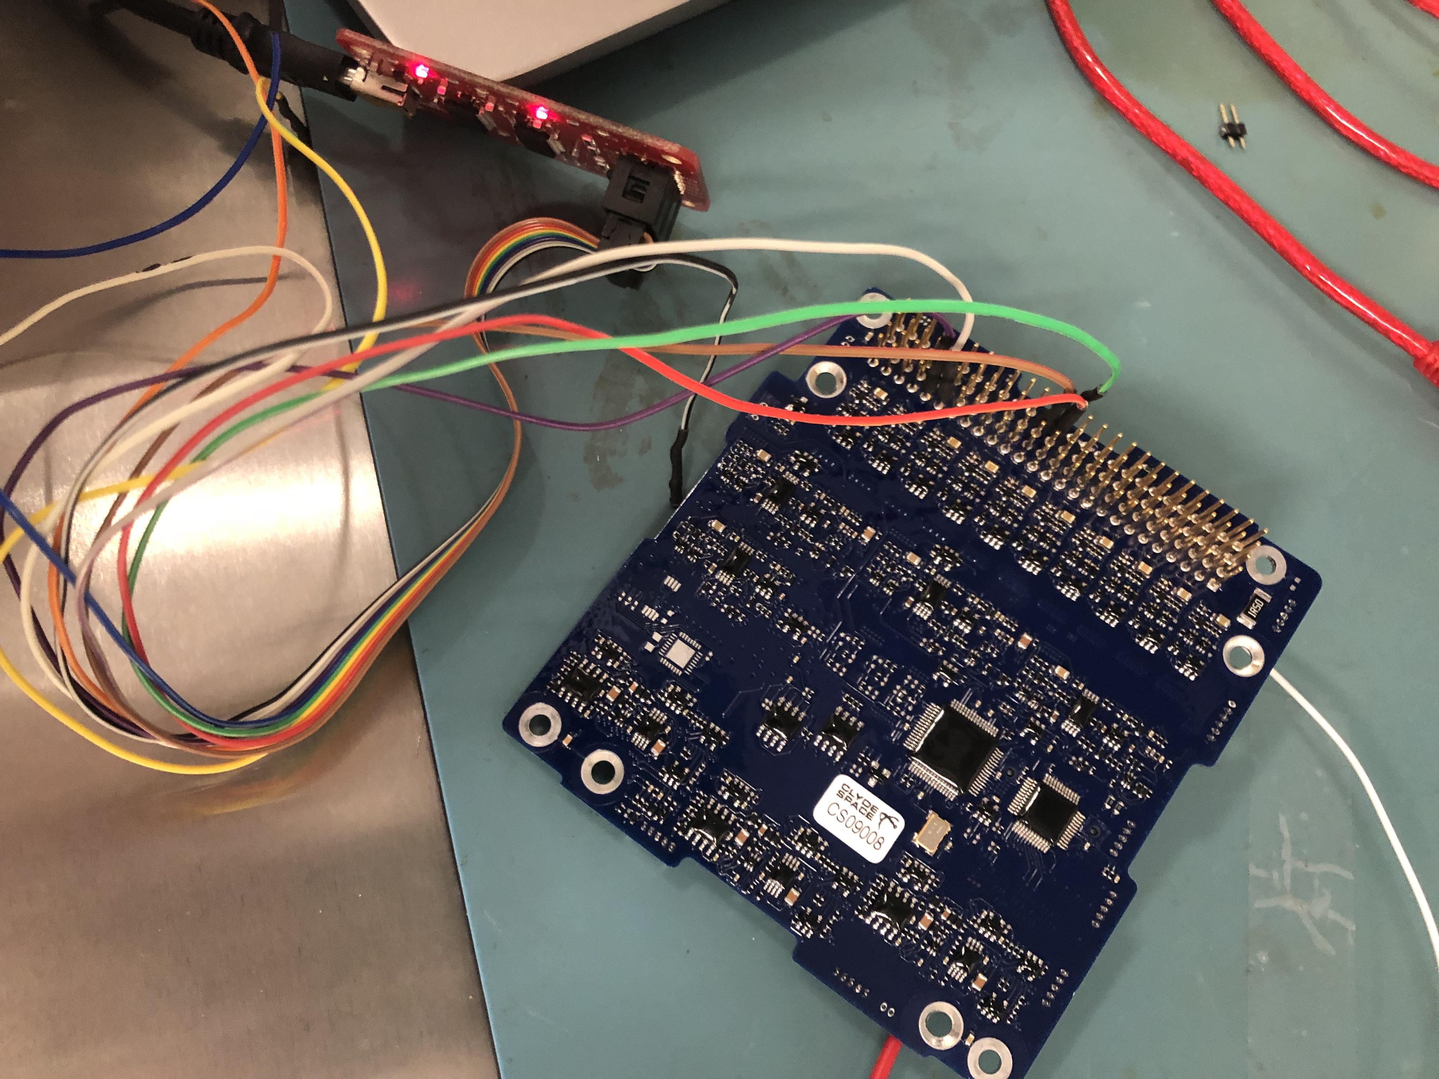
Testing
All testing is done in the clean room, with components being interfaced with I2C protocol
Using various systems including TI TM4C's, Arduinos and bus pirates.

